Slide 1

Progress Seminar on Rock-Paper-Scissor Game
Presented By
Mr. Shivam Singh
Guided By
Ms. Roshani Talmale
Department of Computer Science & Engineering
S. B. JAIN INSTITUTE OF TECHNOLOGY MANAGEMENT AND RESEARCH,NAGPUR
An Autonomous Institute, Affiliated to RTMNU, Nagpur

Slide 2
Contents
Problem Statement & Objectives
Introduction
Flowchart
Technology to be Used
Screenshots
Advantages & Applications
References
2
S. B. Jain Institute of Technology Management and Research

Slide 3
Problem Statement & Objectives
Problem Statement
This project is to create a program for playing a game of rock-paper-scissors between computer and user. The game will consist of exactly three rounds of rock-paper-scissors. A user will need to win the majority (i.e greatest number ) of the three rounds to win the game. The game will result in a tie if no player wins the majority of the rounds.
Objectives
To Have Fun.
To Start thinking more carefully.
3
S. B. Jain Institute of Technology Management and Research

Slide 4
Introduction
Rock Paper Scissor (which is also called Stone Paper Scissor) is a hand game and played between two people, in which each player simultaneously forms one of three shapes. The winner of the game is decided as per the below rules:
Rock vs Paper -> Paper wins.
Rock vs Scissor -> Rock wins.
Paper vs Scissor -> Scissor wins.
In this game, the user will be asked to make choice and according to the choice of user and computer and then the result will be displayed along with the choices of both computer and user.
S. B. Jain Institute of Technology Management and Research
4

Slide 5
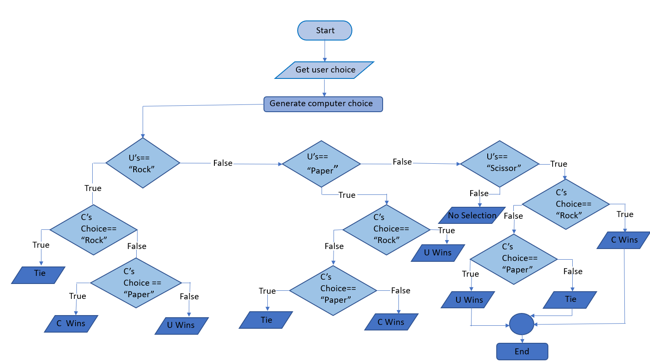
System Design: Flowchart
S. B. Jain Institute of Technology Management and research
5

Slide 6
Technology to be Use
Language: C
Library/API/Framework: #include<stdlib.h>
#include<time.h>
IDE: VS Code
Hardware used: Laptop(8 GB RAM)
S. B. Jain Institute of Technology Management and research
6

Slide 7
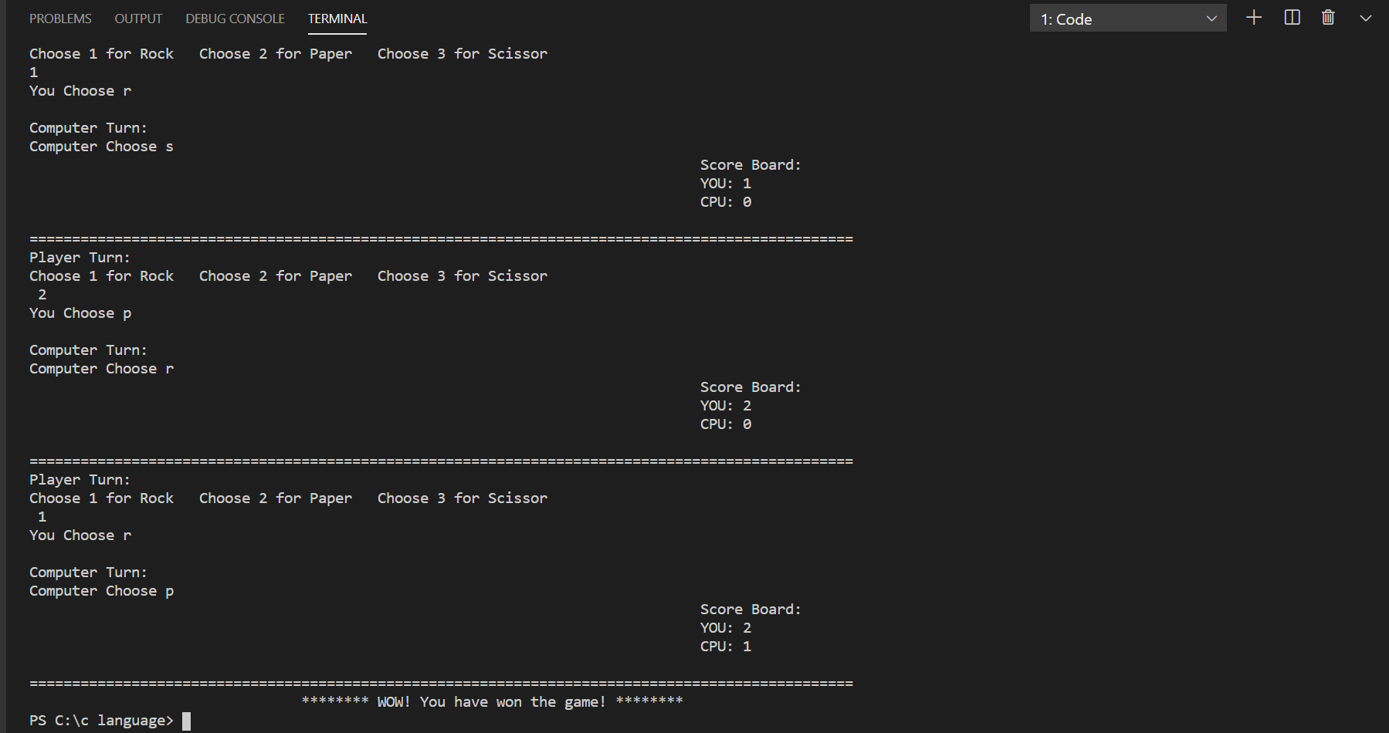
Screen Shots
S. B. Jain Institute of Technology Management and Research
7

Slide 8
Advantages & Applications
To have fun in free time.
To use constants and variables appropriately.
To implement functions given prototypes and use them appropriately.
To write logical expressions and selection statements in C.
S. B. Jain Institute of Technology Management and Research
8

Slide 9
References
Websites:
www.w3schools.com
www.geeksforgeeks.org
S. B. Jain Institute of Technology Management and Research
9

Slide 10
Thank You

